Slide 1
Processing Employee Separations
Arie R. Baker, Assistant Manager, Core HR
Office of Human Resources Management

Slide 2
Processing Employee Separations in SAP

Slide 3

What is a Separation?
Separation occurs when the employment contract or agreement between an employee and the County comes to an end by means of resignation, termination, or end of assignment.
Involuntary Separation occurs when an employee is removed from employment by the County through means other than layoff. This includes, but is not limited to, suspension or termination.
Voluntary Separation occurs when an employee chooses to leave County employment, typically providing at least two weeks’ notice.
Notes:
Want to emphasize that we are discussing separations.
Retirement is the withdrawal from one's position or occupation or from one's active working life. A person may also semi-retire by reducing work hours or workload. Many people choose to retire when they are elderly or incapable of doing their job due to health reasons.

Slide 4

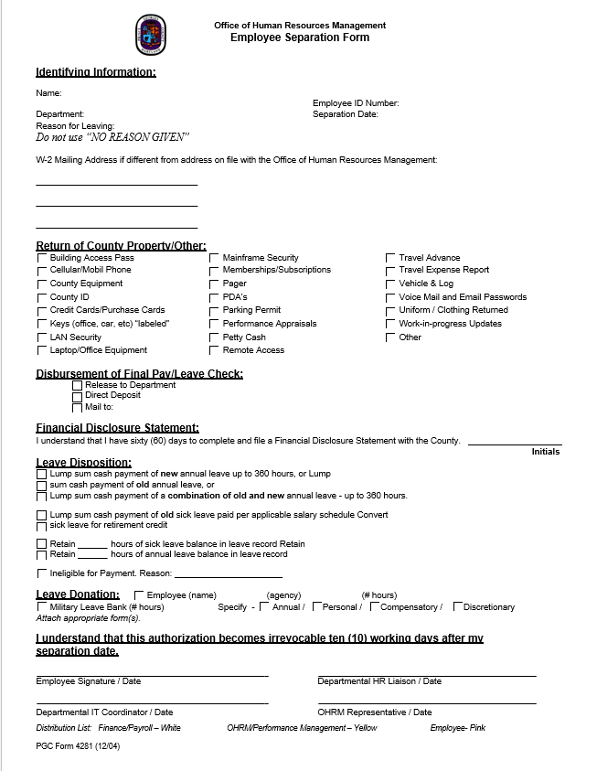
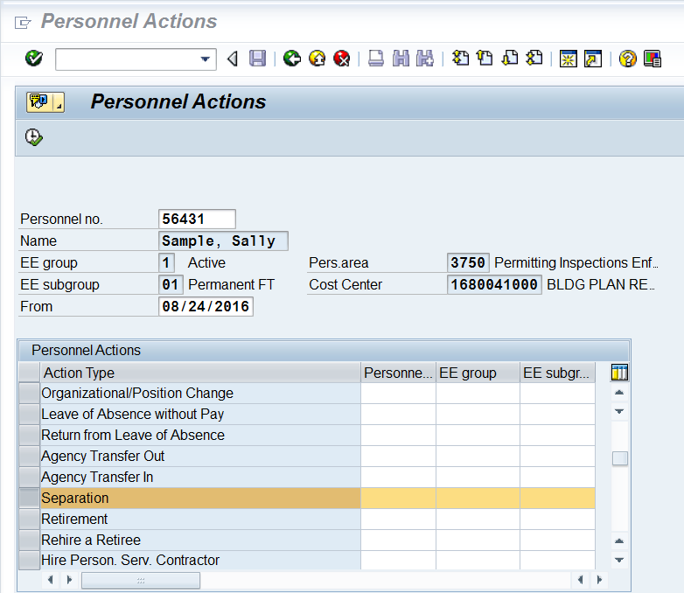
What do you need to Process an Employee Separation?
PA40

Slide 5
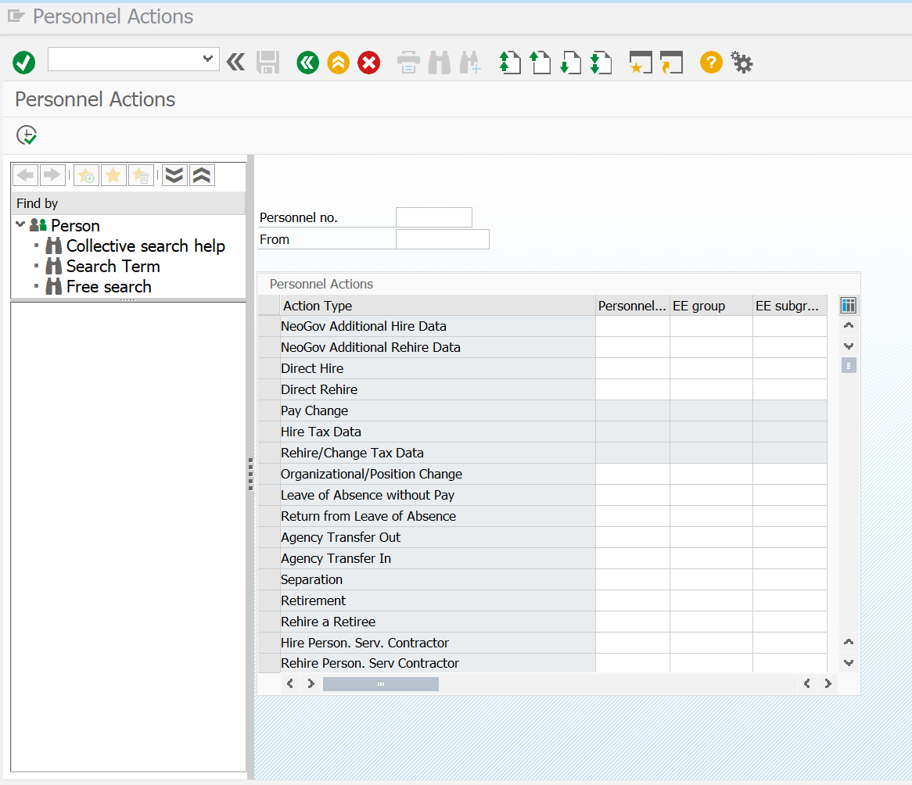
Processing an Employee Separation in SAP
Transaction Code PA40 will open the Personnel Actions Window.
Enter the following information:
Personnel No. (EIN)
Last Day of Work
Select Separation
Click Execute
98765
09012022

Slide 6
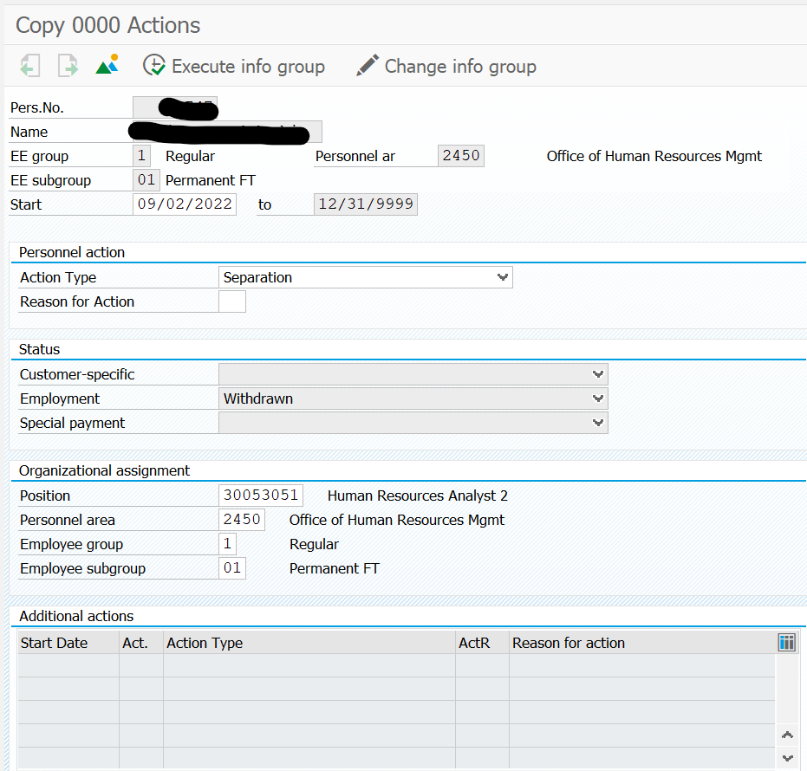
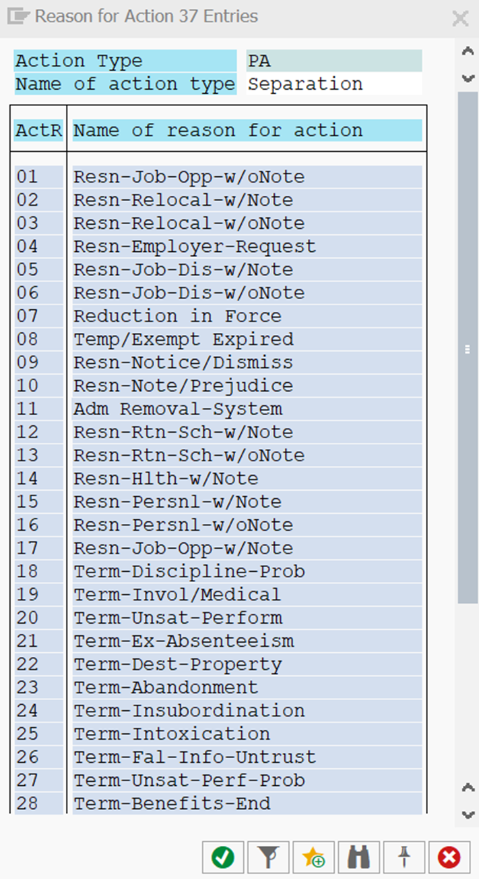
Processing an Employee Separation in SAP
Confirm the Start Date is the date after the Last Day Worked
- this is the First Day of Separation
Select the Reason for Action
  Resignation?
    With note?
    Without a note?
  Termination?
  Temp/Exempt Expired?
Notes:
The reason for action is very important. It needs to be accurate in the event something comes up in the future such as an unemployment claim.

Slide 7
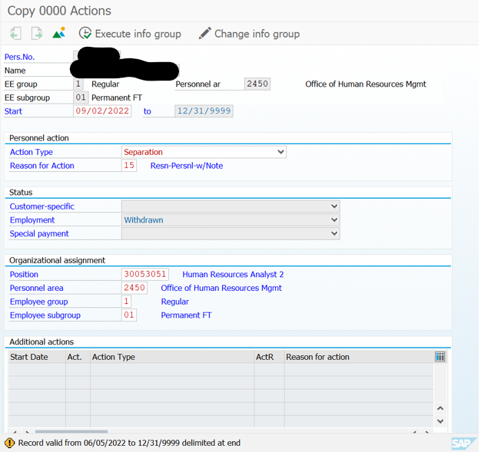
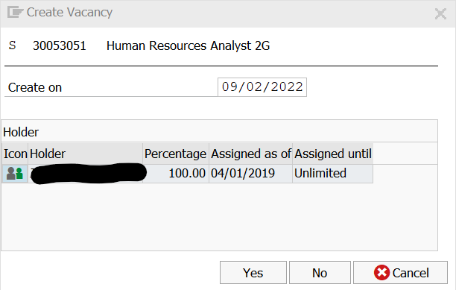
Processing an Employee Separation in SAP
Once you’ve entered the Reason for Action executed the selection, the record will be updated.
SAP is going to ask you to confirm that you are creating a vacancy.
The date the vacancy begins should match the date the separation begins.

Slide 8
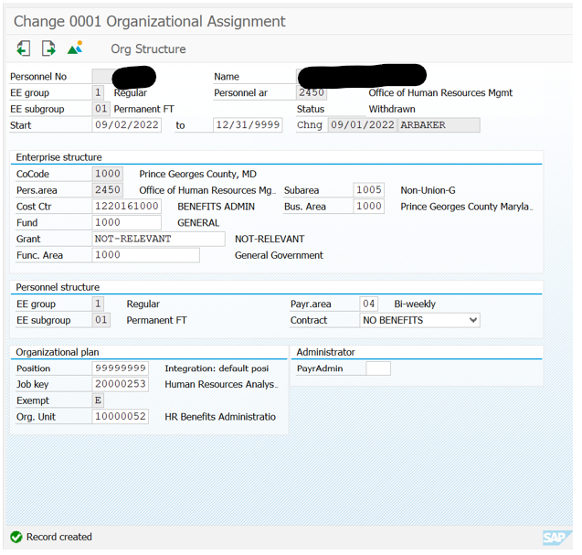
Processing an Employee Separation in SAP
The employee record has now been updated.
Be sure to confirm the position number is now 999999999.
Save your entries.

Slide 9

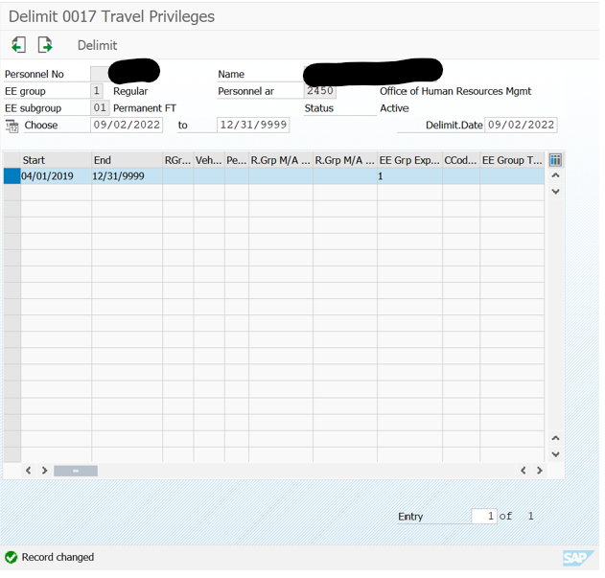
Processing an Employee Separation in SAP
County employees have travel privileges which must be delimited.
Highlight the row and click Delimit.
Notes:
Don’t skip this action.

Slide 10
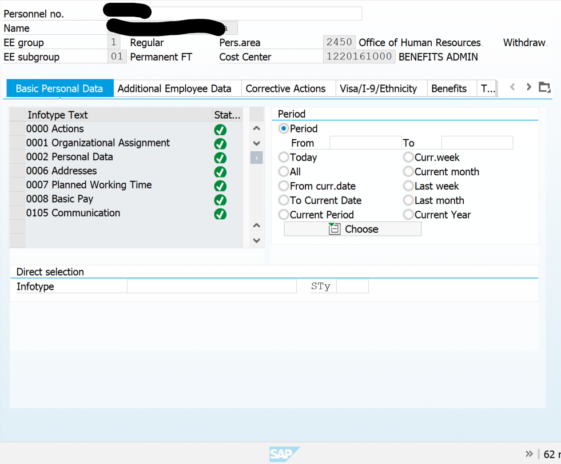
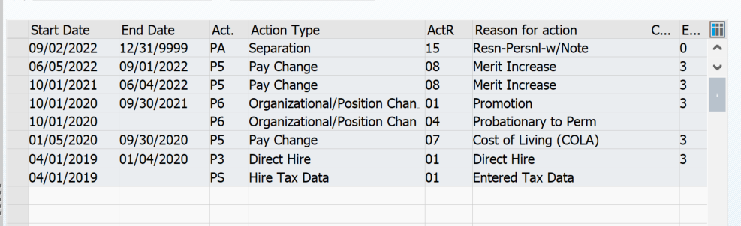
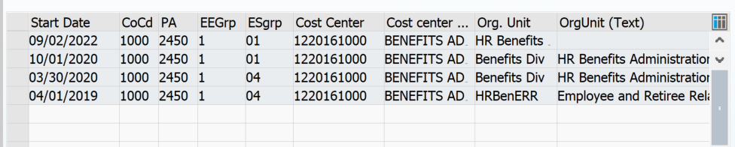
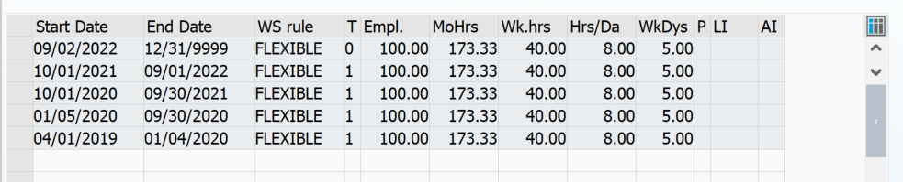
Processing an Employee Separation in SAP
Check Your Work!
Using PA20, review every Info Type to confirm the dates are entered correctly.
0000 Actions
0001 Organizational Assignment
0007 Planned Working Time

Slide 11
What are we looking for in your Separation Requests?
Is the form completed entirely?
Identifying Information
  Name and EIN accurate
  Reason for Leaving
  Mailing Address
Employee Signature
HRL’s Signature

Slide 12



Employee Separation Has Been Processed
Once Core HR has reviewed and confirmed the separation has been processed correctly, you receive a confirmation e-mail and the document is submitted to the Payroll Department for final processing.
Notes:
If the separation was not properly processed, Core HR will delete the action and contact the Agency to inform them of what needs to be corrected. This can be related to a pensions or benefits info type.
Separations should be processed within five business days of employee’s last day. Can be processed once the resignation letter has been received.

Slide 13
Things to Keep in Mind when an Employee Separates from County Employment
Separation Action in SAP
Separation Financial Disclosure Statement
Training Commitments
Can be completed as soon as you receive the Letter of Resignation
MUST be completed within five (5) business days of the employee’s last day
All Agency Filers are required to complete a separation FDS
Most filers use their County email address which they won’t have access once offboarded
Best Practice would be to inform OEA that a filer will be separating once the resignation is received.
If an employee fails to be employed with the County for the agreed amount of time after completion of a training paid for by the County, they are required to reimburse the County.
If the employee is required to reimburse the County, it would be either from their final payroll check, annual leave payout, or by submitting a payment within 30 days of separation.
Notes:
$1,000 to $1,999 = one year commitment
$2,000 to $3,999 = two year commitment
$4,000 and above = three year commitment

