Slide 1

FY 2021 Local Impact Grant Application Workshop
Prince George’s County Local Development Council (PGCLDC)
WEDNESDAY, MARCH 31, 2021
Presenter: Office of Management and Budget (OMB)

Slide 2

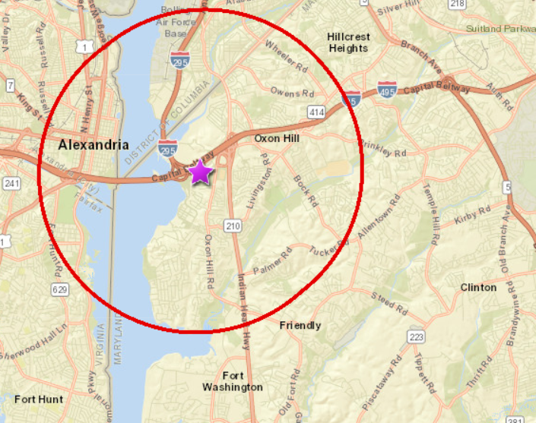
FY 2021 Local Impact Grant
What is the Local Development Council?
What is the Local Impact Grant?
Prince George’s County Local Development Council Website
https://www.princegeorgescountymd.gov/1125/Local-Development-Council

Slide 3
Workshop Agenda
Grant process timeline
Local Impact Grant application overview
Supporting documentation requirements
Reporting requirements
Reminders
Submission instructions
Questions

Slide 4
FY 2021 Local Impact Grant Timeline
Description | Date
Public notification/announcement of FY 2021 PGCLDC grant | March 19, 2021
Grant preparation workshop | March 31, 2021
Grant application deadline | April 16, 2021
County notification of procedurally disqualified applicants | May 14, 2021
PGCLDC application review process | May 7 – June 11, 2021
Report to the full PGCLDC by the PGCLDC Grant Review Committee of recommended awardees for final consideration and public vote | June 16, 2021*
County notification of unsuccessful applicants | June 25, 2021*
Public announcement of award recipients | June 25, 2021*
Grant funds available/issued no later than | June 30, 2021*
* Indicates dates are tentative and are subject to change.

Slide 5
FY 2021 Local Impact Grant Application

Slide 6
FY 2021 Local Impact Grant Application
Section I – Organization Information
Basic information about your organization
Section II – Service Category
What is your organization’s primary service?
Section III – Project/Program Information
Name of project or program

Slide 7
FY 2021 Local Impact Grant Application
Section IV – Other Sources of Funds
List other sources of funds
Section V – Support Category
What type of funding are you requesting?
Section VI – Project Category
Select one category that best describes your organization’s project
Section VII – Primary Age Group of Clients Served
Identify the target community that your project will benefit

Slide 8
FY 2021 Local Impact Grant Application
Section VIII – Partnership
Do you partner with other nonprofits to provide this service?
Section IX – Fiscal Sponsor
Are you using a fiscal sponsor to secure this grant?
Section X – Reporting Requirements
Submit two reports on how the funds are spent

Slide 9
FY 2021 Local Impact Grant Application
Section XI – Proposal Narrative
Narrative descriptions of your program/project
Section XII – Organizational Financial Information
Detail your organizational and program budget
Section XIII – Prior Year Grants
Has your organization received County funding in the past?

Slide 10
FY 2021 Local Impact Grant Application
Section XI – Proposal Narrative Formatting
Use a separate Word document for your narrative responses: a maximum of 8 pages, 12-point font, and 1-inch margins.
Title each narrative response with the heading of the question; do not repeat the text of the question.
Be specific with your responses, try not to duplicate information, and use measurable language.
Please review the questions on page 4

Slide 11
FY 2021 Local Impact Grant Application
Section XII – Organizational Financial Information
You must use the tables on pages 5 and 6 to present financial information.
Organizational budget vs program/project budget.
For Organization Income, detail the percentage of each line item.
Use the given line items, that may mean condensing some of the line items from your accounting system.
Do not attach any other budget information.

Slide 12
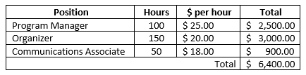
FY 2021 Local Impact Grant Application
Section XII – Organizational Financial Information
If you are requesting funds for compensation, use a separate sheet to identify each position, its estimated hours of work, cost per hour, and the total compensation request.

Slide 13
Supporting Documentation Requirements

Slide 14
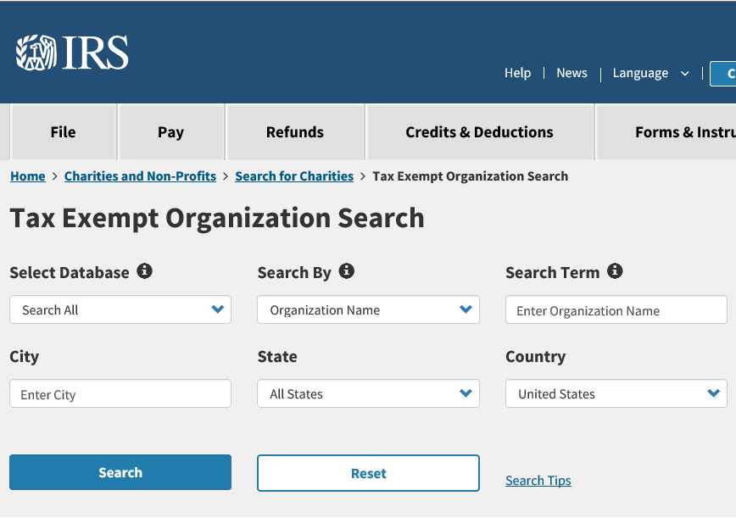
Supporting Documentation
IRS Exempt Organizations Select Check
Please visit https://apps.irs.gov/app/eos to obtain a copy of your IRS Exempt Organizations Select Check results. This document verifies your organization’s federal tax-exempt status is currently in effect and not revoked for failure to file your Form 990 Series return for three (3) consecutive years. Information can be searched by Organization Name or Employer Identification Number (EIN).

Slide 15
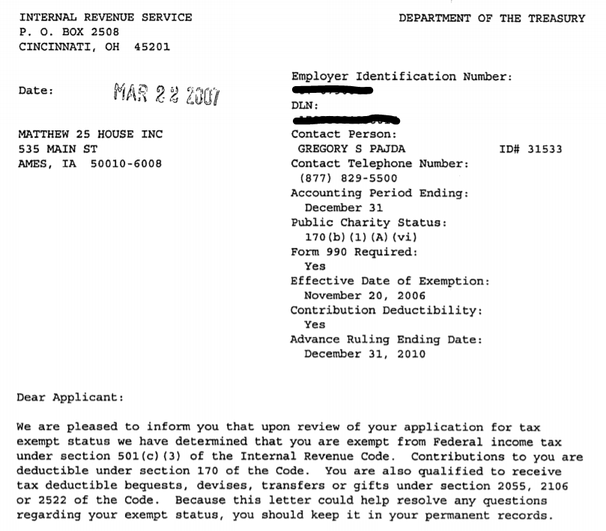
Supporting Documentation
IRS Tax Determination Letter
A copy of the organization’s IRS Tax determination letter verifying IRS 501(c)3 federal tax-exempt status. The organization’s full legal name must match Maryland’s State Department of Assessments and Taxation (SDAT) records.

Slide 16
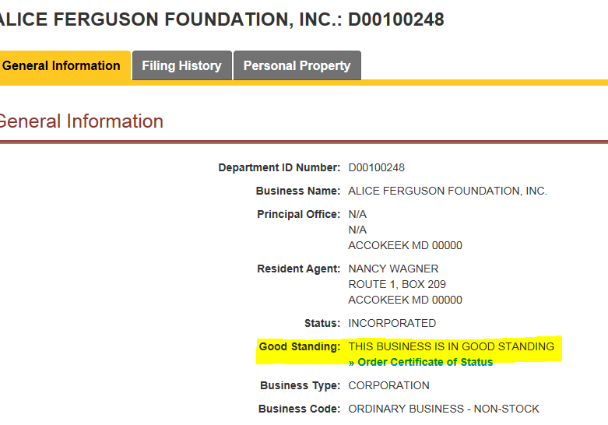
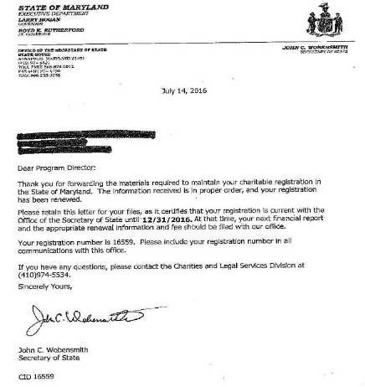
Supporting Documentation
Certificate of Status
Aka Certificate of Good Standing, this document has general entity information showing that the organization is currently in good standing with the State where your organization was incorporated. The date on the certificate must be within six months of the application’s submission.
Certificate of Status
Charitable Registration
NOT ACCEPTED
Issued by the Maryland Department of Assessments and Taxation
Proves that a corporation is authorized to transact business in Maryland and all fees, taxes, and penalties owed to Maryland are paid
Can be obtained online from Maryland Business Express
The date of the print out must be within six months of submission
Issued by the Secretary of State
Required in order to solicit charitable contributions
Requires Form (COR-92) completion and a possible fee
Requires annual renewal
Not required to solicit government funds

Slide 17
Supporting Documentation
Financial Statements
Include previous year Financial Audit Report or most recently filed IRS Form 990 – (Return of Organization Exempt from Income Tax). If your organization has both, please submit the Financial Audit Report. Audited financial reports must be prepared in accordance with Generally Accepted Accounting Principles and be audited by a Certified Public Accountant. Unaudited financial statements, balance sheets, reviews or draft versions are not acceptable.
Even though most tax-exempt non-profit organizations do not pay federal taxes, most are still required to file an annual informational return with the IRS. This annual reporting return is called a Form 990, 990 EZ or 990-N.
Your organization’s Form 990 is due on the 15th day of the 5th month after the end of the organization’s taxable year. For example, if your fiscal year follows the calendar year, your 990 due date is May 15th. If your fiscal year is July 1st – June 30th, your 990 is due on November 15th.
Instead of filing an annual return, certain small organizations (annual gross receipts are $50,000 or less) may file an annual electronic notice, the Form 990-N (e-Postcard). The due date for Form 990-N is the “initial return due date”. Extended due dates do not apply.
If an organization fails to file Form 990 three years in a row, the IRS will automatically revoke its tax-exempt status. Since 2011, more than 500,000 nonprofits across the country automatically lost their tax-exempt status for this reason.

Slide 18
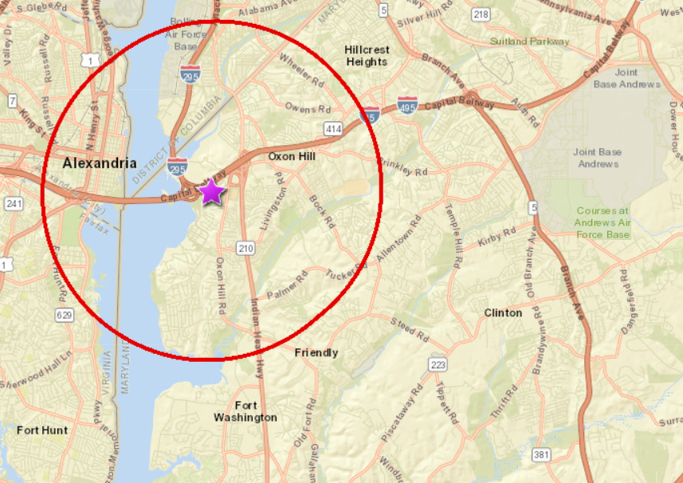
Supporting Documentation
Letter of Support
Include one (1) Letter of Support with an original signature from a community group, PTA/PTO, or church located within the radius, as evidence of community need. Use the following link to confirm radius https://princegeorges.maps.arcgis.com/apps/webappviewer/index.html?id=c0f50714f9824d9f9d8760a5df348de1
Please provide a copy of a most recently executed Memorandum of Understanding for each partner that must be signed by all parties (if this request includes partner organizations), i.e. Prince George’s County Public Schools, Fiscal Sponsor.

Slide 19
Supporting Documentation
Copy of your Organization’s Mission statement on a separate page
Board of Directors/ Trustees list
Job descriptions for each position you are requesting support
Your Organization’s written Conflict of Interest policy and procedures
IRS form W-9 – Signed request for taxpayer identification number
Prince George’s County ACH Enrollment (Electronic Funds Transfer) form
Office of Management and Budget (OMB) verified SAP vendor number OR Completed SAP Vendor Request form

Slide 20
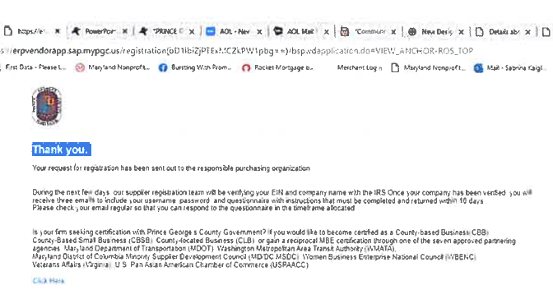
Supporting Documentation
SAP Vendor Request form
If you do not have an OMB verified SAP vendor number already, you will register as a vendor with the County using the website in the application.
https://pgcsup00.sap.mypgc.us/registration(bD1lbiZjPTExMCZkPW1pbg==)/bspwdapplication.do#VIEW_ANCHOR-ROS_TOP
After you have submitted the registration form, save the confirmation page that comes up afterwards.

Slide 21
Reporting Requirements
Midpoint and final reports include narrative and financial questions
  Specific due dates will be in the FY 2021 award letter
If you received funding in FY 2020, your midpoint report was due March 26, 2021. You need to submit that before your FY 2021 application.
A new reporting template will be provided.
According to the Assurances you sign in the application, the LDC reserves the right to:
  Programmatic evaluation
  Site monitoring visits
  Request general ledger detail and receipts as supporting documentation for reports

Slide 22
Reminders
Do’s
Contact OMB to verify vendor registration number
Always follow instructions
Be attentive to all formatting requirements
Proofread your proposal
Present realistic grant budgets
Address sustainability after the grant is over
Email pgcldcgrants@co.pg.md.us for any questions that you have
Please Don’t
Wait until the last minute
Forget to include the required supporting documents
Make assumptions; instead ask for clarification
Copy anyone else’s grant - although it’s similar

Slide 23
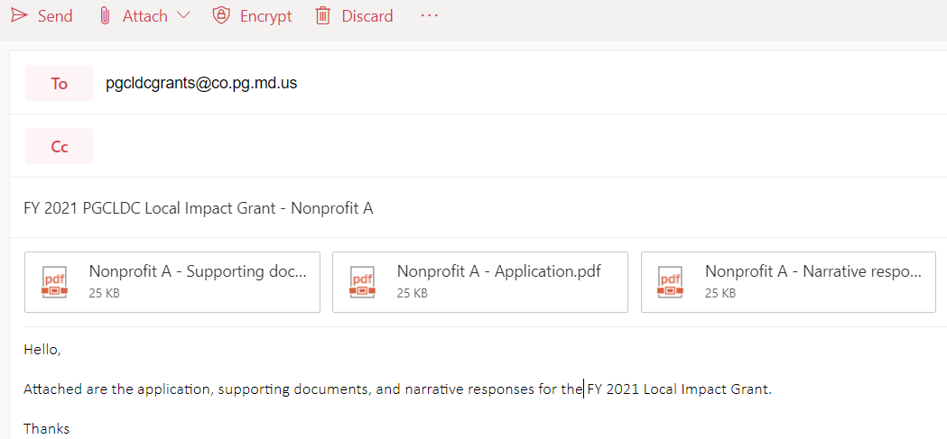
Submission Instructions
Email the application with no more than three attachments to pgcldcgrants@co.pg.md.us with a subject line of “FY 2021 PGCLDC Local Impact Grant – Nonprofit name” by Friday, April 16, 2021 5:00PM. Emails received after 5:00PM will not be accepted. The three attachments are the application, supporting documents, and the narrative responses.

Slide 24
Questions?
pgcldcgrants@co.pg.md.us

Slide 25
Thank you!

